Slide 1
Project for Asarah BeTeves
Rabbi Yudkowsky
Grade 4
Providence Hebrew Day School

Slide 2
Asarah BeTeves
This project is meant to make the loss of the Beis Hamikdash more tangible
Begin with a focus of what the Bais Hamikdash meant as a center for Yidden especially during Yom Tov!
Idea that it was a focus of Yiras Shomayim
Also with its churban we have no Melech
Discuss what a Yiddeshe king is like Dovid who said “See Hashem how I am different…” Berachos
Discuss the Lishchas Hagazis that had the Sanhedrin
No Machlokes with the Sanhedrin and the idea of Zakain Mamrei
With the churban there is no Sanhedrin
The project has us “rebuild” the Bais Hamikdash in 3-D
The crown remembers Malchus
The Torah and Mirrer Rosh Hayeshiva represents the Sanhedrin

Slide 3
How to do the project
Cut out pictures on pages 3-6
Trim so excess is removed
Number the back of each using the number next to the picture
Place the papers on card stock or card board to see how to place when glued
You can use a shoe box to make it fancier
Use glue stick and glue 1 and 2 in their spots
Using puffy dots carefully match 3 to picture 1 and glue in place
Repeat for piece 4
Using a thicker puffy dot or two puffy dots position and glue piece 5
Let the student choose which crown (piece 6) they wish to us and use more puffy dots to attach anywhere
Attach piece 7 in the same way as 6

Slide 4
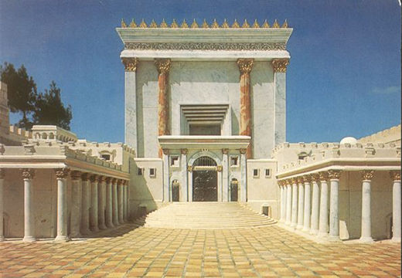
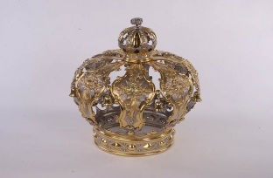
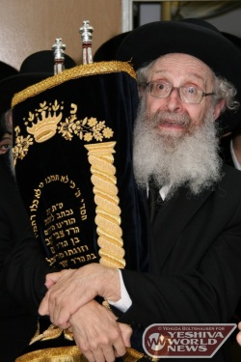

Slide 5
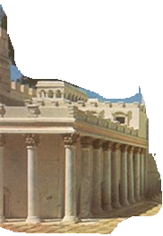
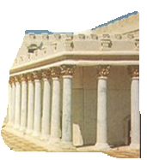
3
4

Slide 6
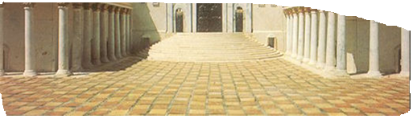
1

Slide 7
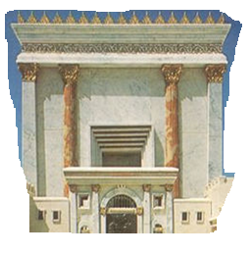
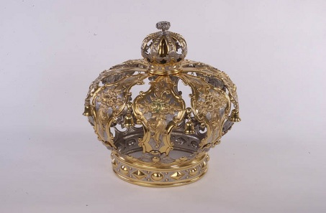
6
5

Slide 8

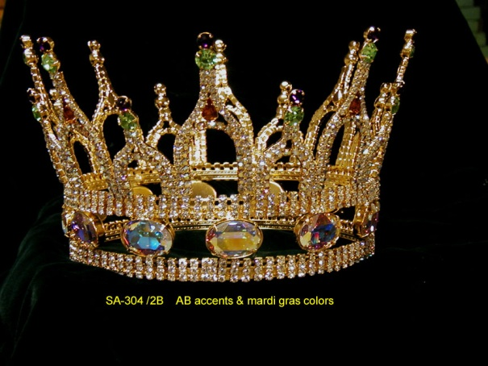
7
6
You can cut the white or leave it
2

